Slide 1

Present Education Overview
Fall 2018

Slide 2
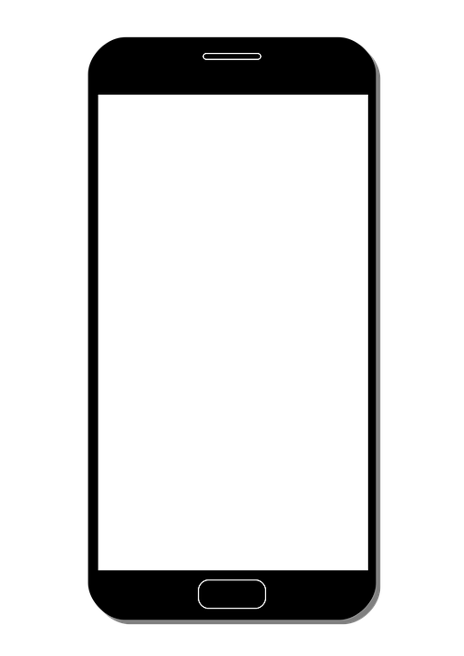
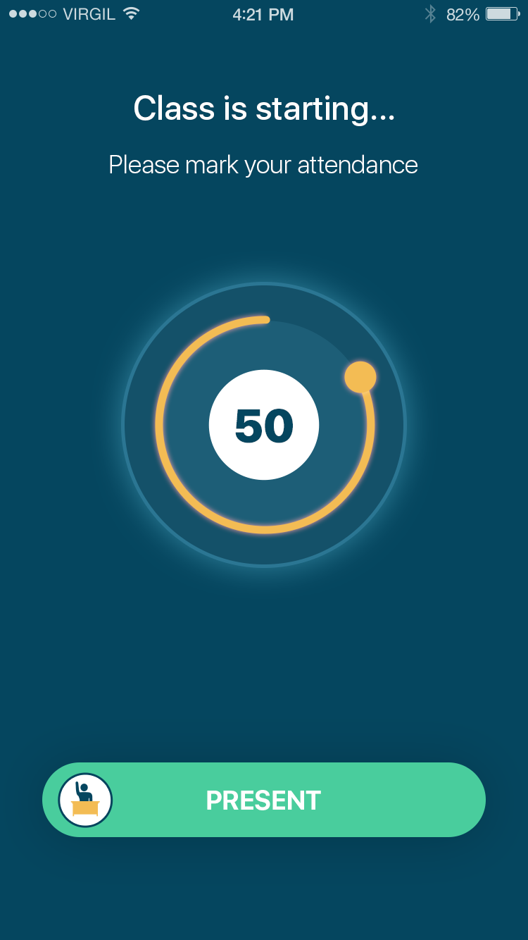
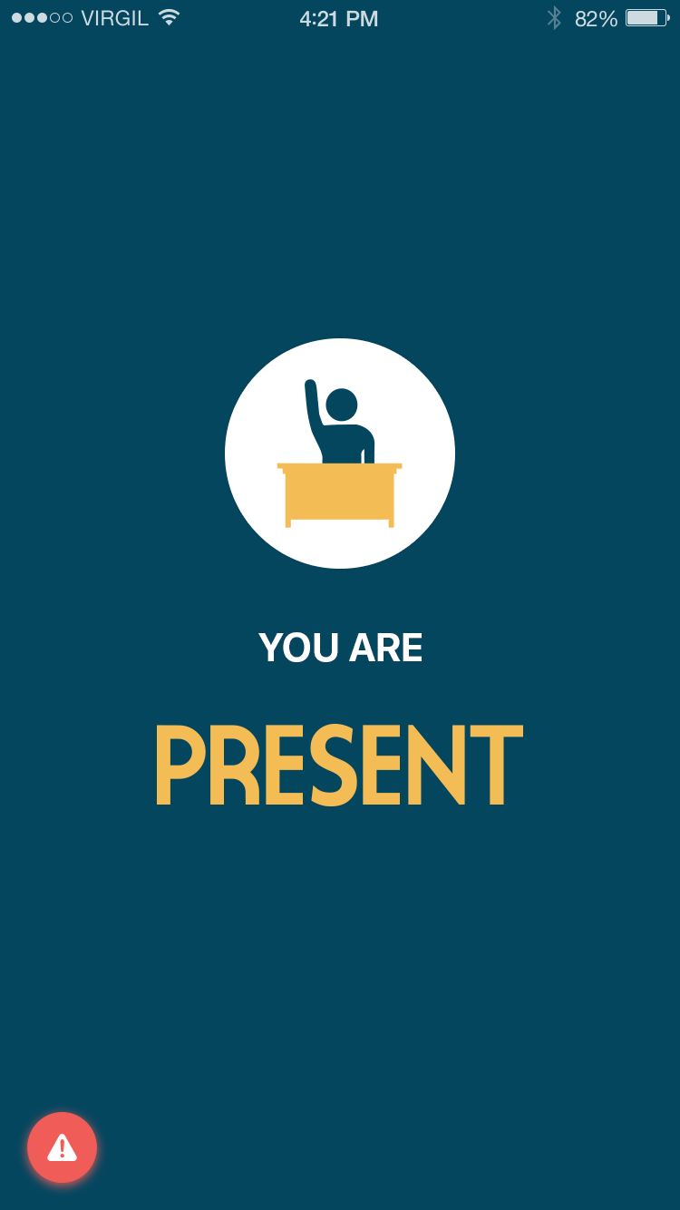
Our Vision
Present leverages student devices to advance their learning – powering educational apps while disabling the distractions of texts, games, and social media.

Slide 3
The Problem
Teachers are frustrated and exhausted with having to compete against smartphones for student attention.
Great education technology apps exist but 1:1 programs with Chromebooks and iPads are too expensive for most school districts.
Some classrooms have experimented with using student smartphones for classroom activities but “responsible use” policies are impossible to enforce.

Slide 4
Solution: Present Education
A platform that…
…disables phone distractions like texts, games, and social media when students are in class or on campus
…allows teachers to use the ed-tech apps they need without having to worry about policing their students
…keeps students engaged by allowing them to learn using their own devices

Slide 5
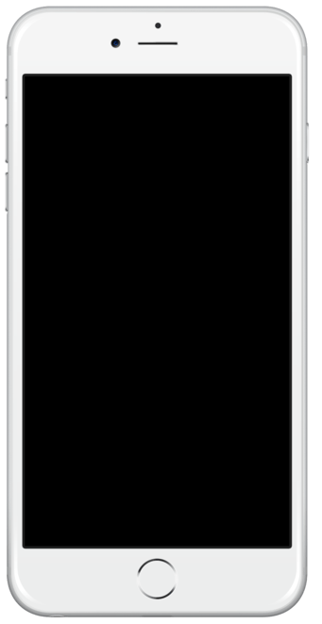
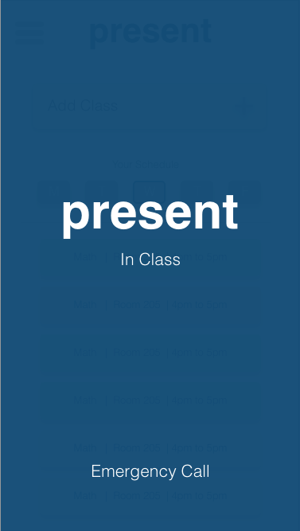
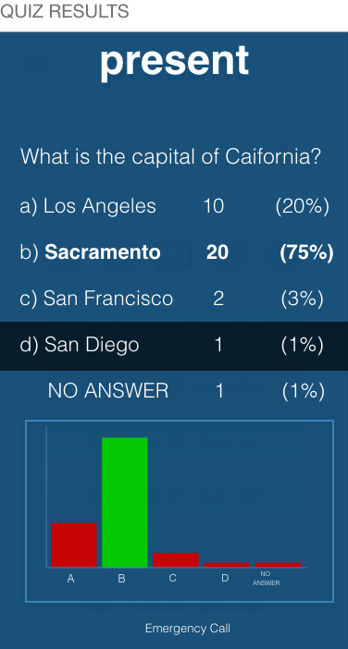
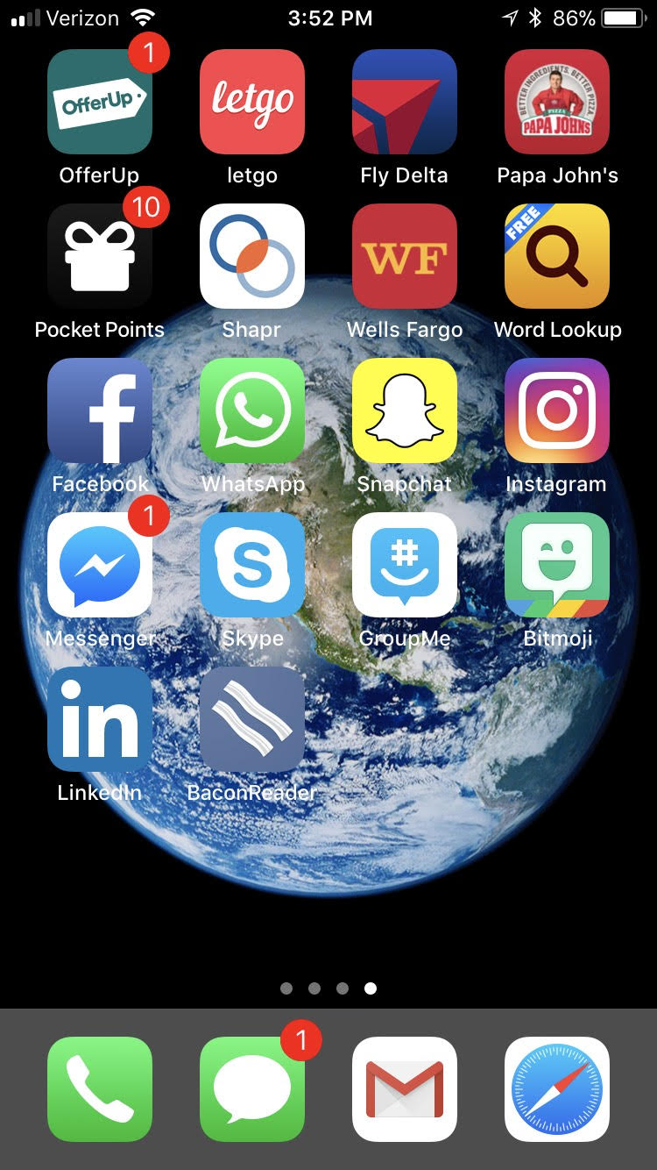
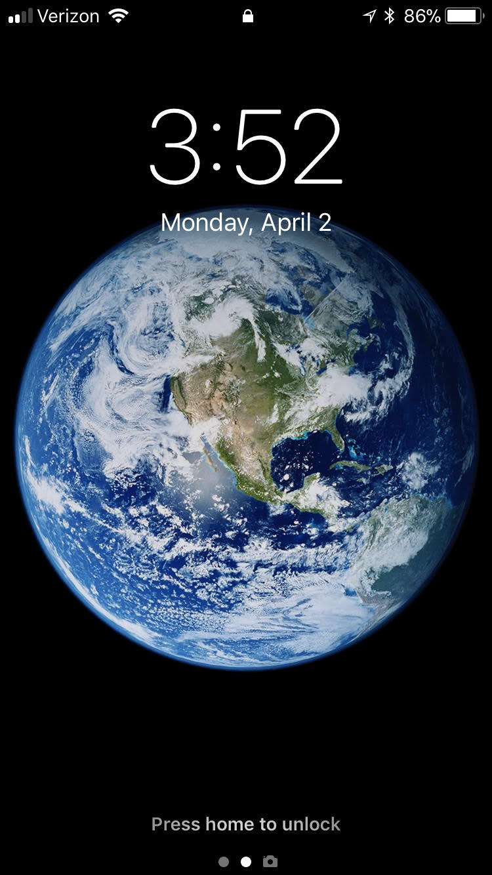
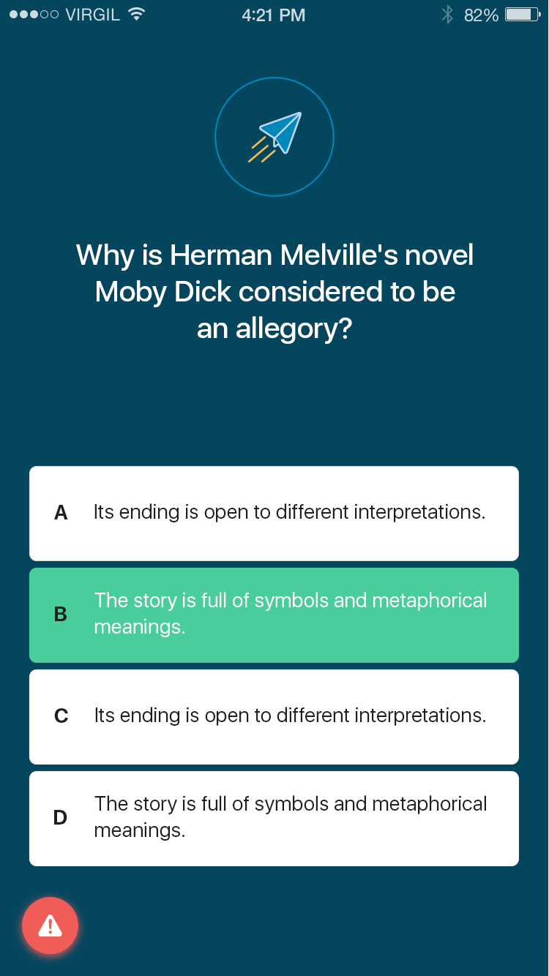
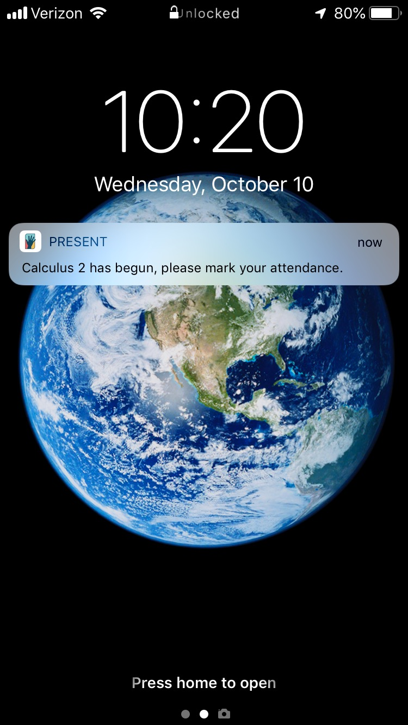
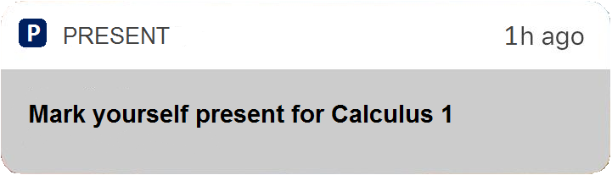
How Present Works
1
At start of class, students are notified to mark themselves Present.
2
Student phones are locked. They cannot text, instagram, facebook, or use other distracting apps.
3
Teachers can create, distribute, and view live-quizzes to engage students via devices.
4
At the end of class, student phones are automatically unlocked.

Slide 6
The Market
Source: National Center for Education Statistics
76.5 Million
49.2 Million
8 Million
All Students (USA)
Total Available Market
Secondary & Post-Secondary Students
Total Serviceable Market
Students in OR, WA, CA, & TX
Target Initial Market

Slide 7
Business Model
Phase 1
(Student Revenue)
4 million
$8.91
$36M
Students in OR, CA, WA, & TX
50% Share of Initial Market
Annual Revenue per Student
$0.99/mo for 9 month school year
Recurring Annual Revenue
For Initial Target Market
Phase 1: Schools pay $0.99 per student per month
Phase 2: App partners pay 10% commission fee to integrate
Phase 3: Schools purchase data analytics and insights

Slide 8
Go-to-Market Strategy
Present uses a 3-pronged sales strategy:
Partnership Sales
Transactional Sales
Enterprise Sales
Present creates key strategic partnerships with companies like Learning.com to leverage their sales teams.
Interested educators and administrators can learn about Present online and complete the sales process by talking with an account executive.
Present’s sales team will identify key decision makers, selling through cross-state purchasing consortiums and directly to high-value school districts.

Slide 9
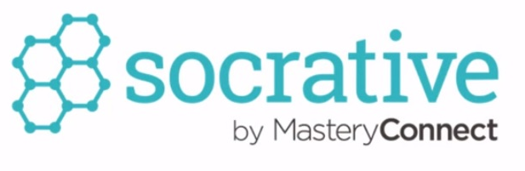











Competitors
Affordable
Lacks Key Features
Addresses Problem
Expensive

Slide 10

Differentiation
Designed for student owned devices | ✔ | ✔ | ✔ / ✖ | ✔ | ✔
Addresses smartphone distractions | ✔ | ✔ / ✖ | ✔ / ✖ | ✖ | ✔
Prevent 3rd party app distractions | ✔ | ✔ | ✔ | ✖ | ✔
Prevent native app distractions | ✔ | ✖ | ✖ | ✖ | ✔
Phone lock non-circumnavigable | ✔ | ✖ | ✖ | ✖ | ✔
Provides classroom engagement tools | ✔ | ✖ | ✖ | ✔ | ✖
Designed for teachers, not IT admins | ✔ | ✔ | ✖ | ✔ | ✔
Affordable for low-income districts | ✔ | ✖ | ✖ | ✔ | ✖
Emergency notification features | ✔ | ✖ | ✖ | ✖ | ✖

Slide 11



Team
Eli Coon
Chief Executive Officer. Strategy consultant at Deloitte, focusing on technology clients. Faculty member at The Catlin Gabel School. B.A. in Philosophy, Politics, and Economics from Claremont McKenna College.
Nauvin Ghorashian
Head of Product. Operations manager at Intel for semiconductor manufacturing. User experience expert. B.S. in Computer Engineering from Portland State University.
Ian Garrett
Head of Technology. Software engineer & project manager. Founder of IT Department at Emerald Media. B.S. in Computer Science from the University of Oregon.

Slide 12
Appendix

Slide 13

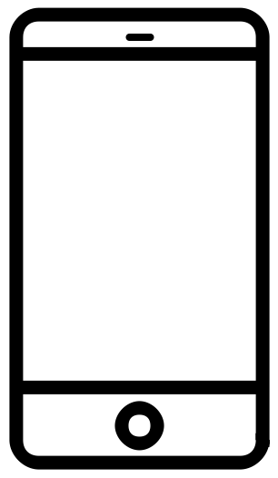
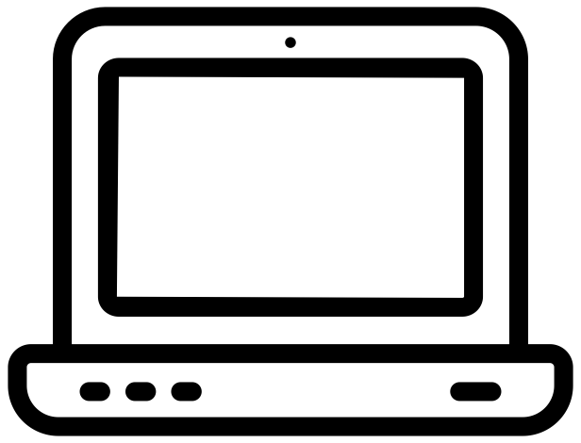

How does Present work for…
Present is a classroom management tool and educational platform designed to eliminate smartphone distractions and improve student engagement
Students
Teachers
Admins
The Present App is an iOS and Android application that students install on their personal smartphones
As a teacher starts a class, each student gets an attendance request notification on their phone
When students mark their attendance with the Present App, they are locked out of accessing any other applications on their phone until the end of class
The Present Dashboard is a website where teachers can see their class details and manage students’ phone lock status
When students mark their attendance at the start of class, their status is reflected on the dashboard
Teachers can also create and submit Learning Checks – live quiz questions that students answer on their phones. Real-time results show lesson understanding on the fly
Admins log in to the Present Web Portal to manage Student, Teacher, Course, and School Information
New teacher and student accounts are created by admins
Admins can create new courses, assign classes to teachers, and manage course schedules

Slide 14
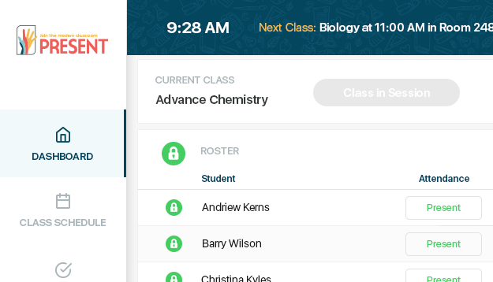
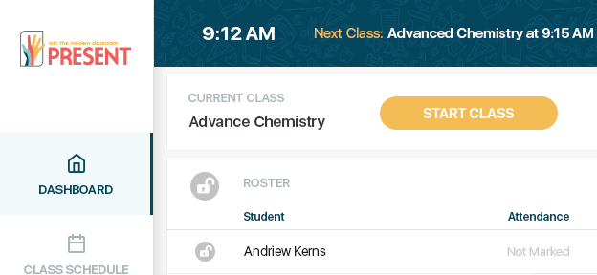
Demo
2
Students receive a notification in the Present App asking to mark attendance – once they are “Present” they can’t leave the application
1
The teacher starts class from the Present Dashboard on their computer or tablet
3
The Present Dashboard shows attendance status in real-time, so the teacher can see which students are “Present” or “Absent”

Slide 15
Geographic Growth

